Slide 1
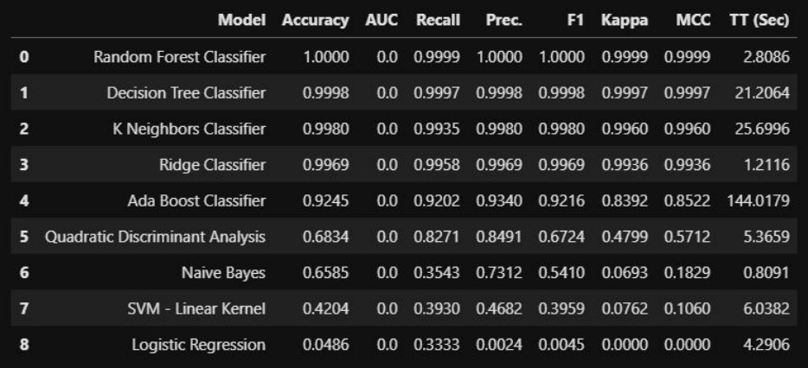
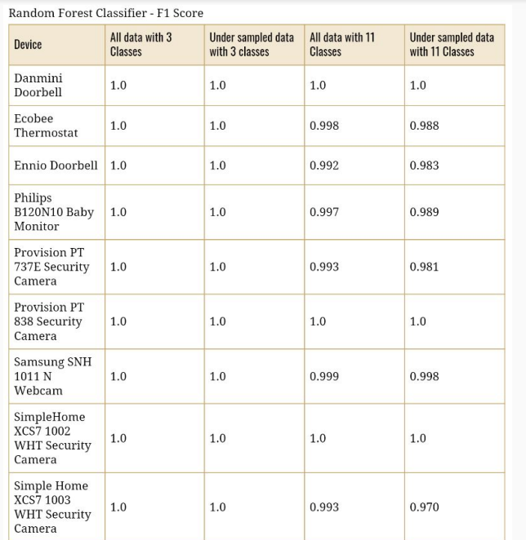
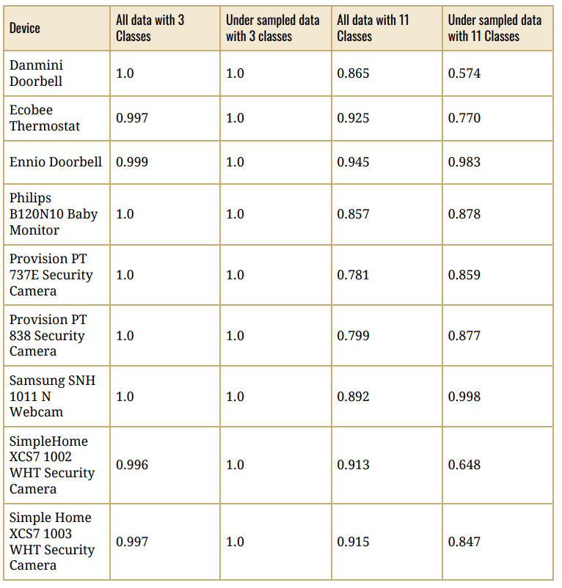
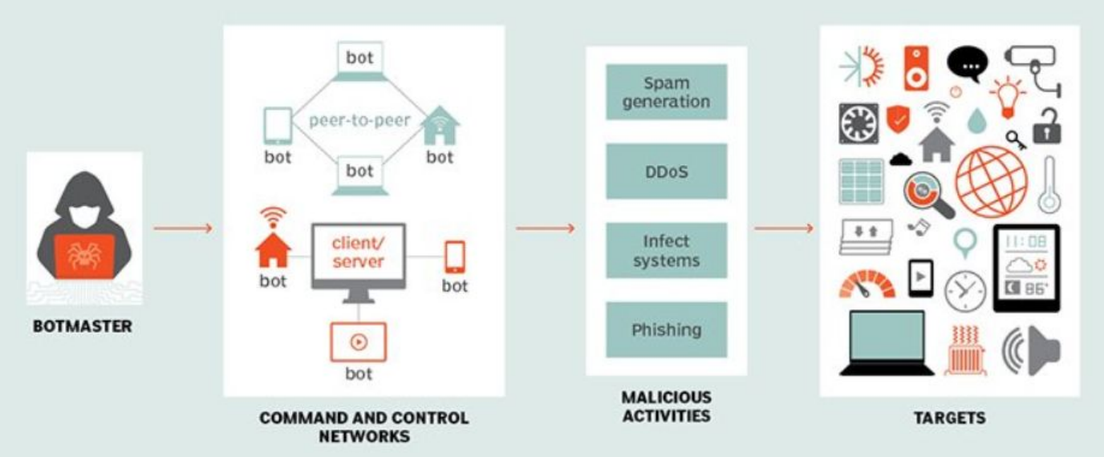
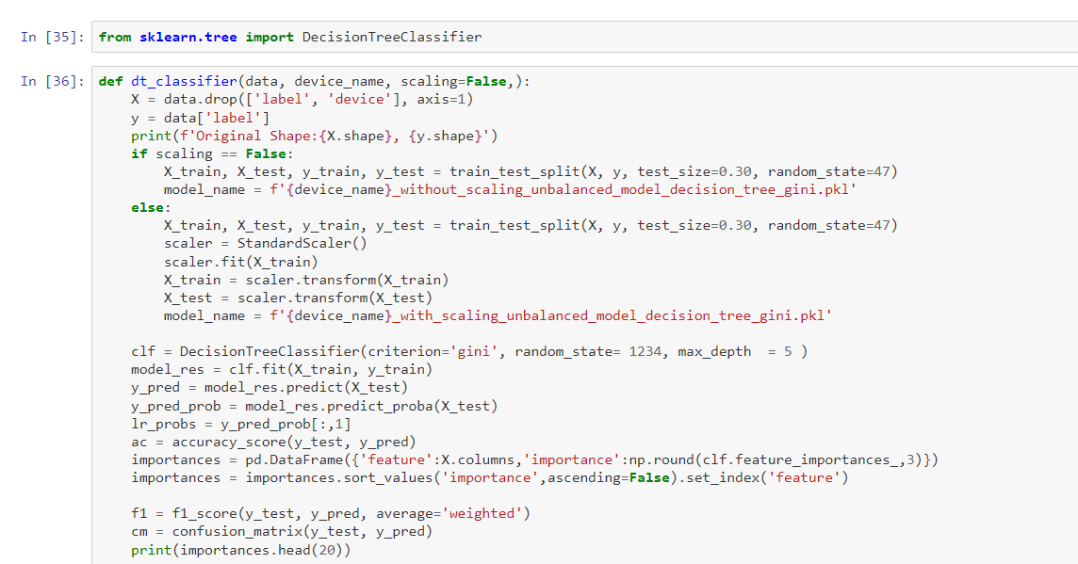
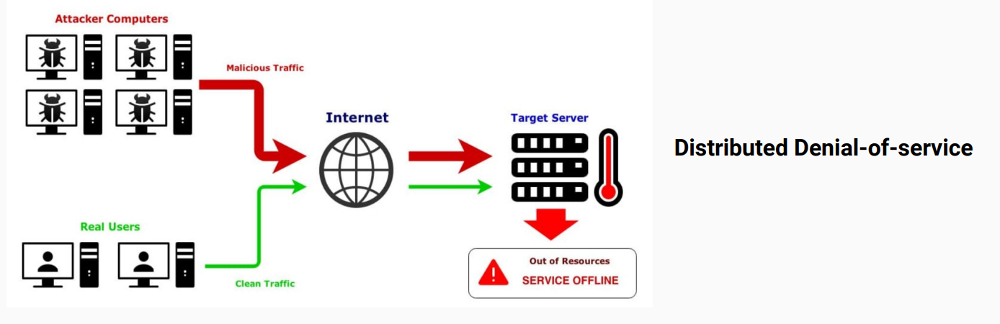

Securing Network Applications via embedded Security Model
Your name, student ID
MSc Project, Supervisor: name
ABSTRACT
Novel model using machine learning algorithm for identify & mitigating botnet-based attacks in an embedded network system.
Approach addresses the Network security challenges faced by bot attacks in embedded
Random Forest and Decision tree are best
RESEARCH METHODOLOGY
Data set:
● 2 type of Malware - Mirai , Bashlite
● 5 Categories and 9 IoT Devices - Baby monitor, Webcam, Security Camera, Doorbell, Thermostat
Modeling
● Supervised Learning
● 3 class & 11 class
● Highly imbalanced data
● Scikit learn and imblearn
● Label Encoding
● Data splitting into training and test data (70% - 30%)
TESTING
Model comparisons
Logistic Regression is the worst and Random forest classifier is the best
DISCUSSION / CONCLUSIONS
we need to develop a model for each device, and I explored four different approaches using this approach. As a result of the EDA assaults, we found that malicious data outnumbers benign data. This is mostly due to attack data being further divided into ten categories. With this in mind, I trained a model with three classes, eleven classes, three classes with under sampled data, and eleven classes with under sampled data.
Due to computer power constraints, I only trained the model for individual devices. This model may be improved and then loaded into the device's software. This has the disadvantage of necessitating the training of a model for each and every device. Which is not sustainable in the long run. As a result, we must develop a generic model capable of identifying malware independent of device kind.
INTRODUCTION
Identify botnet attack on embedded system
DoS attack on embedded network
Who might care?
● Cyber security firms.
● Large financial / corporate enterprises.
● IoT Device Manufacturers.
● Anyone who uses internet !
RESULTS / EVALUATION
DESIGN / DEVELOPMENT
REFERENCES
Ali, I. A. I. A. A. A. A. M. A. R. S. A. S. A. K. a. A. G., 2020. Systematic literature review on IoT-based botnet attack. IEEE.
Almalki, F. A., 2020. Implementation of 5G IoT based smart buildings using VLAN configuration via Cisco packet tracer.. International Journal of Electronics Communication and Computer Engineering, 11(4), 56-67.
SCHOOL OF COMPUTER SCIENCE AND TECHNOLOGY

